Slide 1



SHIELD INSURANCE

Slide 2


ABOUT COMPANY
Shield Insurance is a leading insurance provider, offering tailored policies for life, health, and general coverage. With a focus on innovation and customer satisfaction, They ensure seamless policy management and reliable claims processing. Their commitment to excellence makes a trusted choice for financial security.

Slide 3


OVERVIEW
SALES MODE
CITY
AGE GROUP
POLICY AND
MONTHS
18-24
25-30
31-40
41-50
51-65
65+
MUMBAI
DELHI NCR
CHENNAI
HYDERABAD
INDORE
OFFLINE-AGENT
OFFLINE-DIRECT
ONLINE-APP
ONLINE-WEBSITE
TOTAL POLICY = 9
NOVEMBER 2022
TO
APRIL 2023

Slide 4
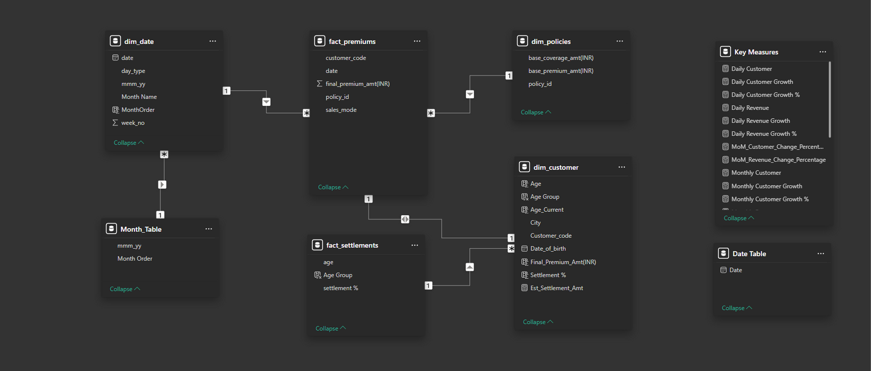


DATA & DATA MODELLING

Slide 5
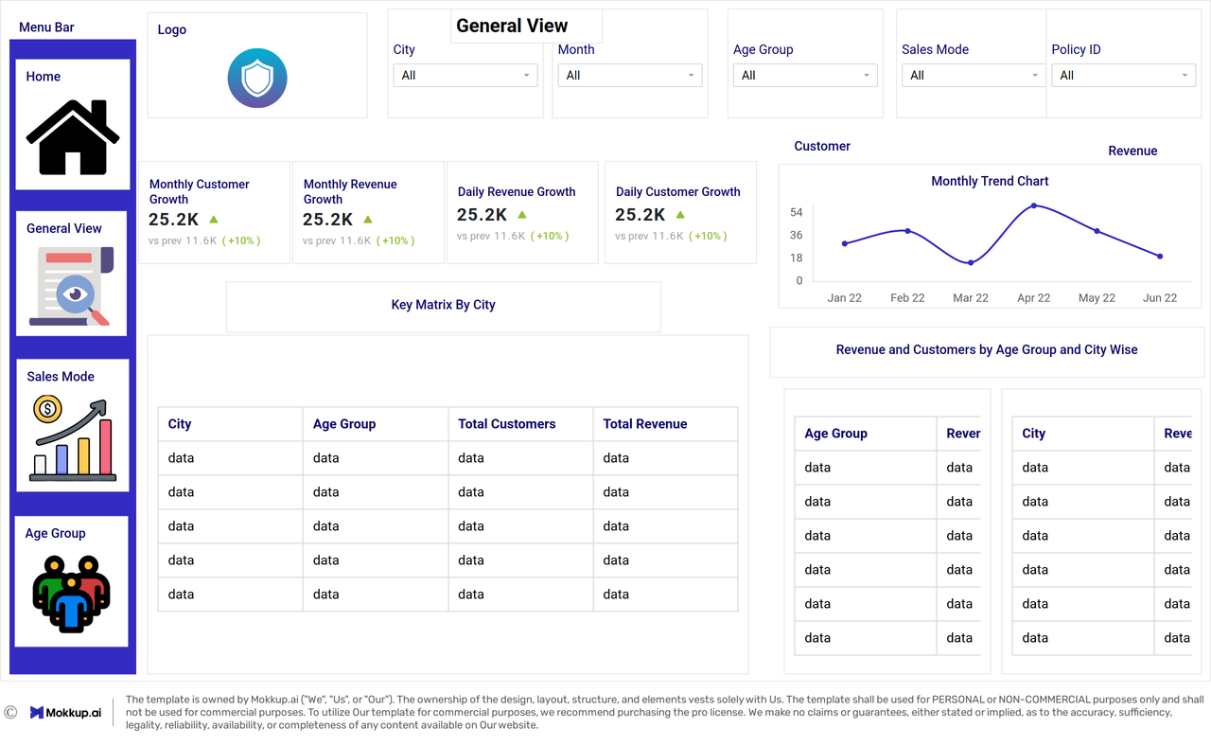
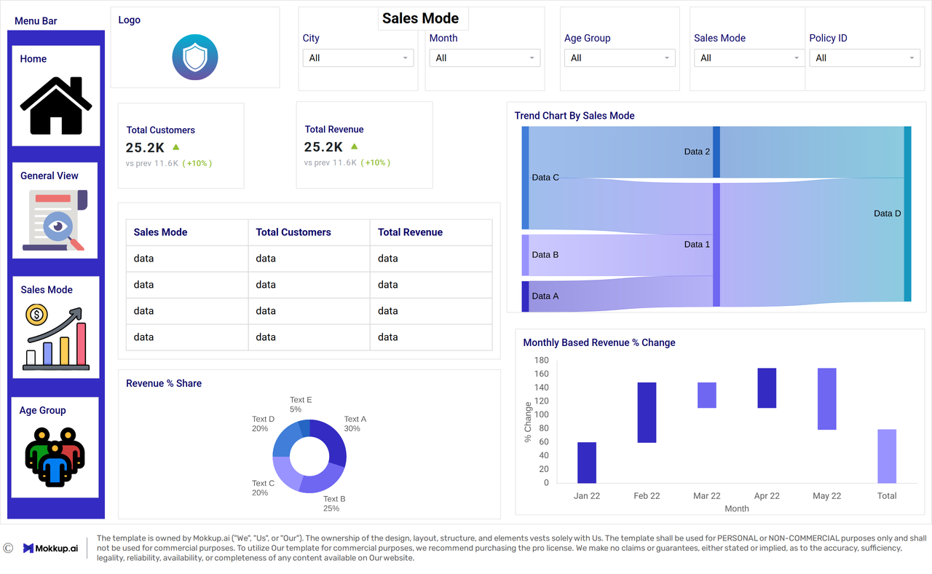
MOCKUPS

Slide 6
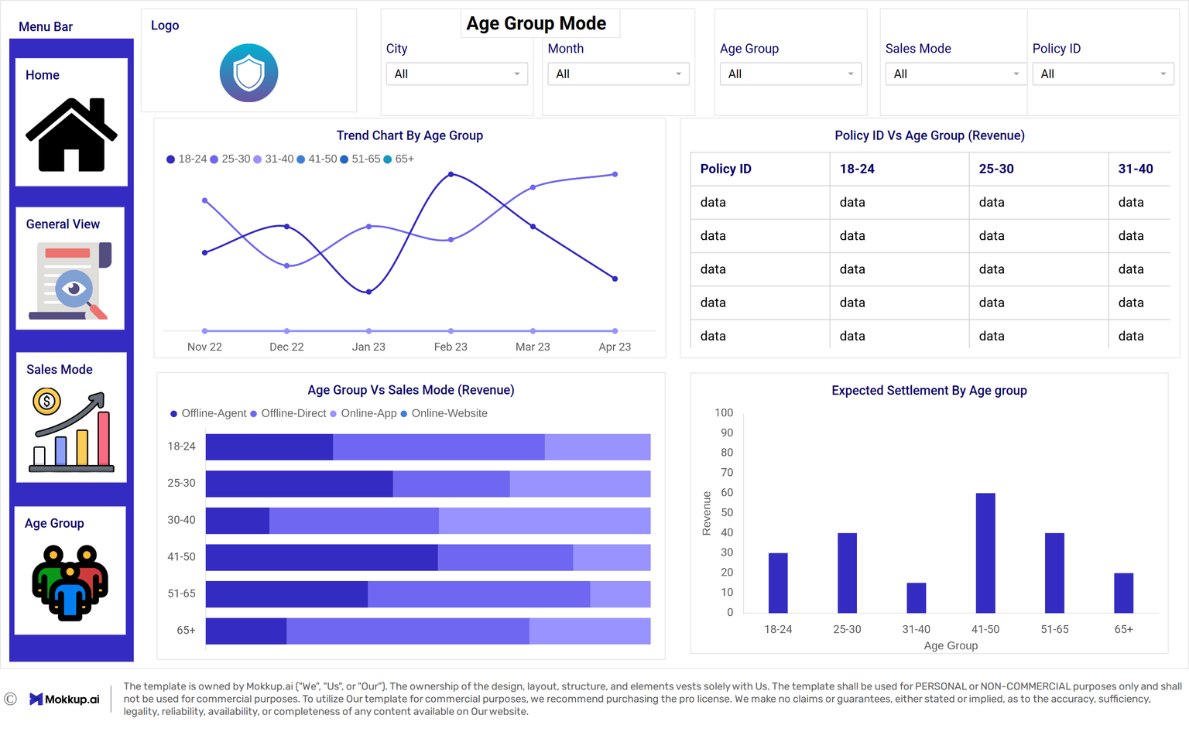
MOCKUP

Slide 7
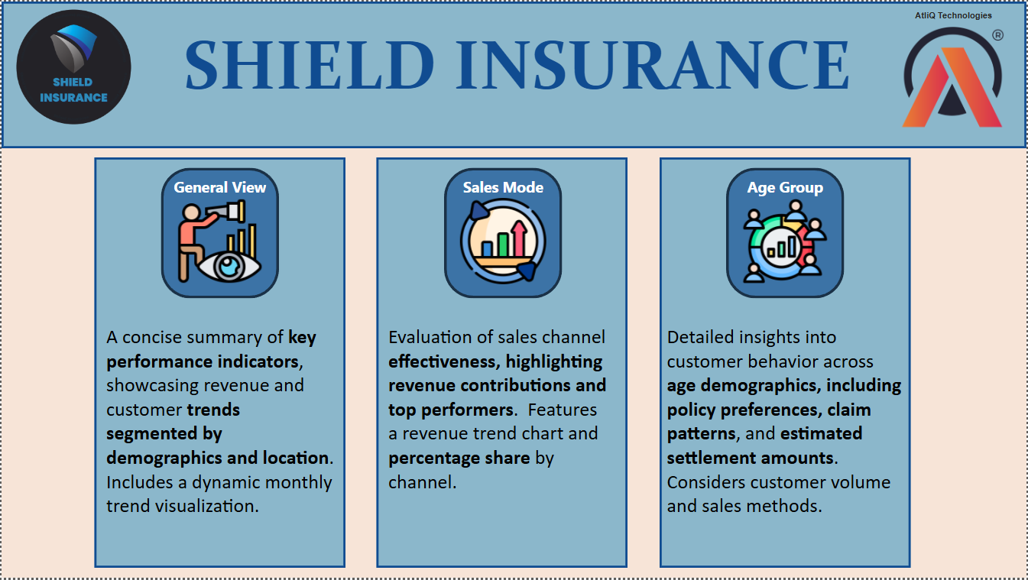

Slide 8
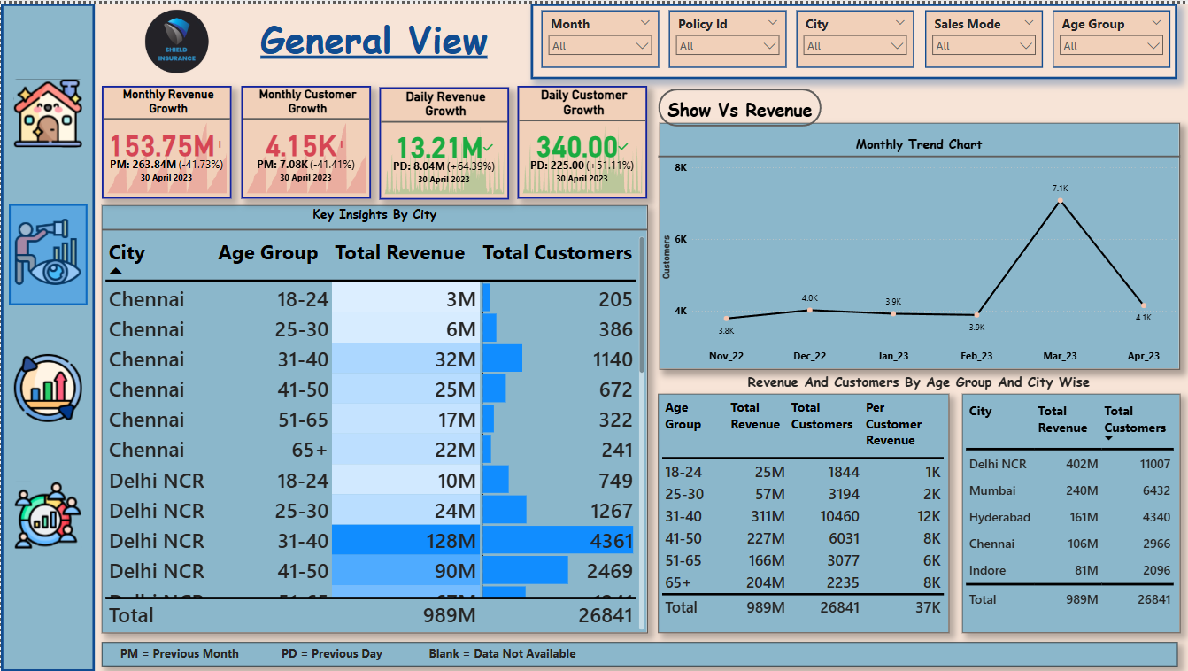

Slide 9
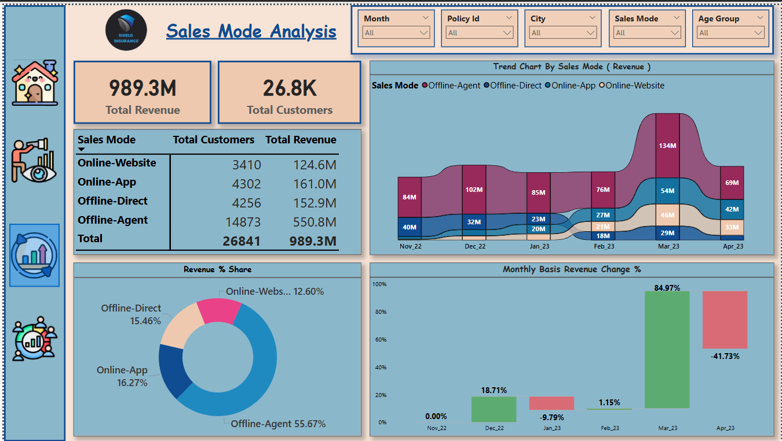

Slide 10
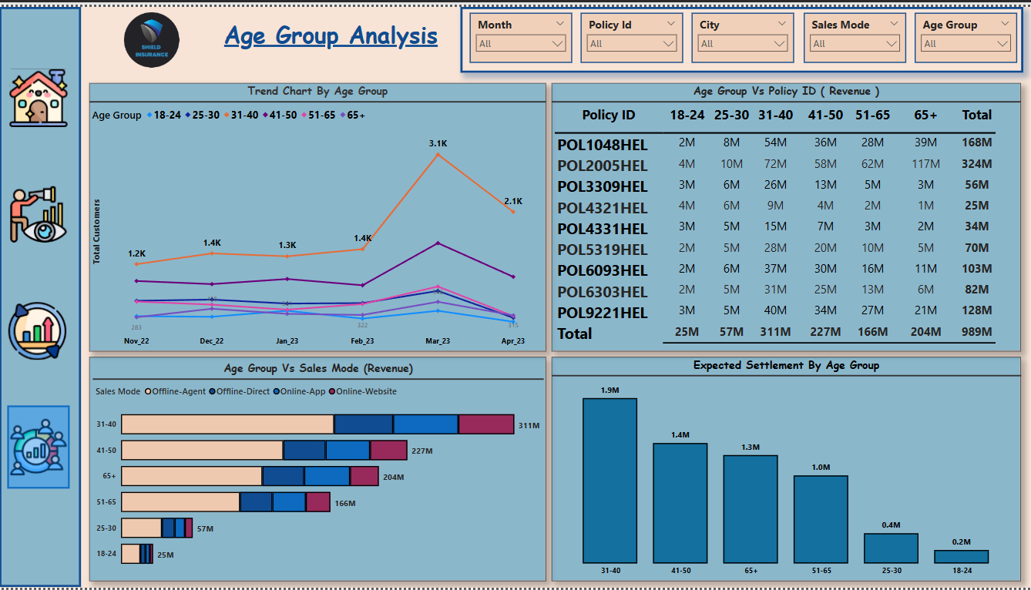

Slide 11

INSIGHTS
31-40 range age group generating the maximum revenue.
Among 4 sales mode offline agent is providing maximum revenue.
In the month of March 2023 the maximum revenue generated.
Delhi NCR and Mumbai generating maximum revenue.
POL2005HEL policy which is making maximum revenue to the company.

Slide 12
THANK YOU

